Slide 1
LENDING CLUB CASE STUDY SUBMISSION
Group Members:
Manoj Kumar Sharma
Adharsh Belagapu

Slide 2
Objectives
Understand the ‘Driving Factors’ or ‘Driver Variables’ behind Loan Default
Loan Lending Organizations may choose to utilize this knowledge for its risk assessment of new loan applicants
Identify type of Loan applicant

Slide 3
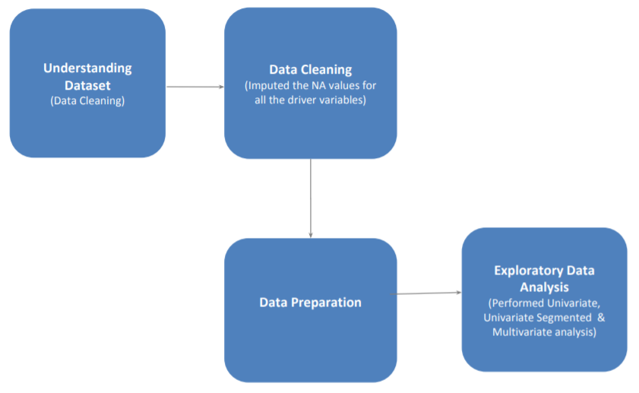
Methodology Used: CRISP-DM

Slide 4
Data Cleaning Steps
Delete columns: Delete unnecessary columns.
Remove outliers: Remove high and low values that may affect the results of analysis.
Missing values: Treat missing values with appropriate approach.
Duplicate data: Remove identical rows, remove rows where some columns are identical.
Filter rows: Filter by segment, filter by date period to get only the rows relevant to the analysis.

Slide 5
Analysis
AIM of project was to analyze how customer variables affect in loan being defaulted
NA values were imputed
Few NA values were deleted from dataset
Some derived columns were prepared using existing columns
Histogram, Bar Charts and Box plots were used in EDA
Outliers were found using Box plots and were mentioned in the EDA
Bivariate and multi variate analysis was done of different columns

Slide 6
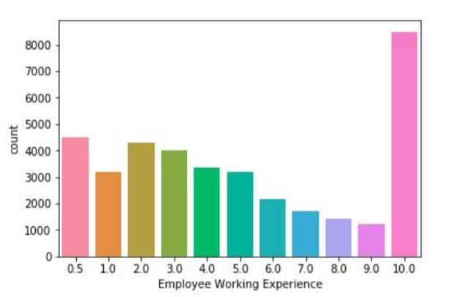
Work Experience analysis of Applicants
High percentage of employees having 10+ years of work experience

Slide 7
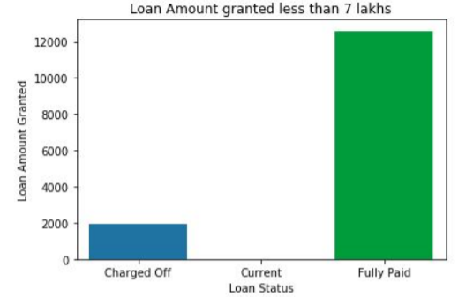
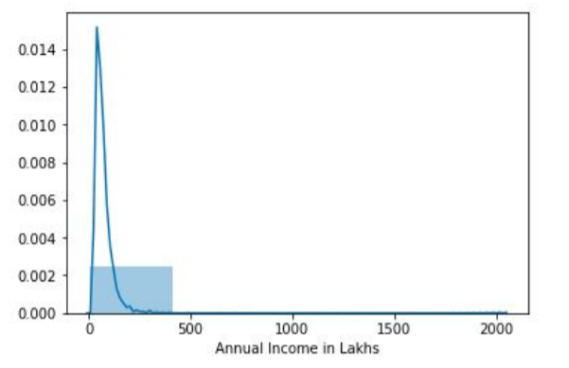
ANALYSIS: LOAN AMOUNT
Most of the loans are fully paid
Very less loans are there which are charged off
Majority of loan applicants have annual income less than 5 lakh

Slide 8
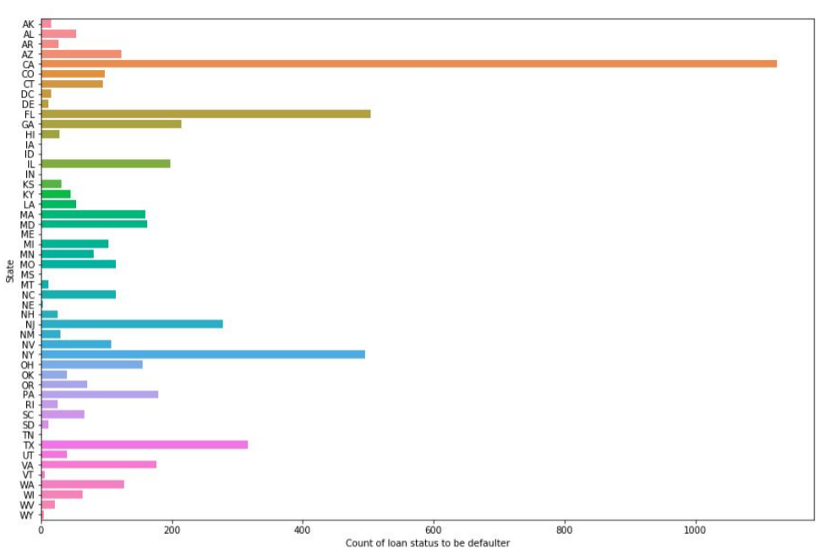
Defaulters by state
California, florida , Newyork and Texas have high probablity for default

Slide 9
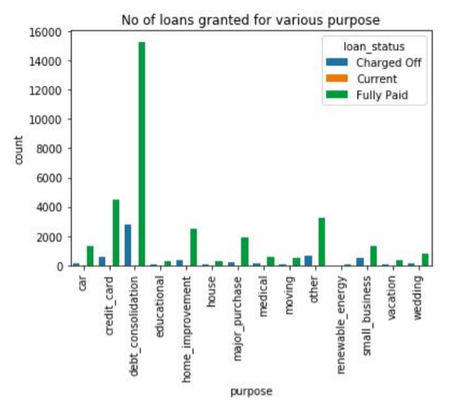
Reason for loan
Most loans were granted for Debt consolidation

Slide 10
Thank you

